Slide 1
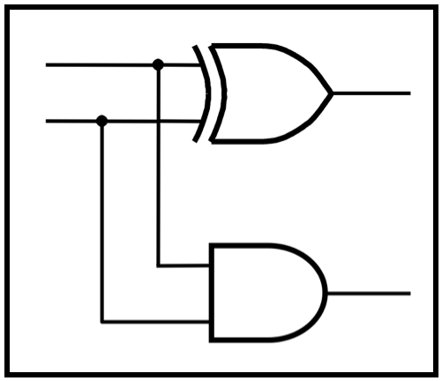
CprE 281:
Digital Logic
Instructor: Alexander Stoytchev
http://www.ece.iastate.edu/~alexs/classes/

Slide 2
Signed Numbers
CprE 281: Digital Logic
Iowa State University, Ames, IA
Copyright © Alexander Stoytchev

Slide 3
Administrative Stuff
HW5 is out
It is due on Monday Oct 3 @ 4pm.
Please write clearly on the first page (in block capital letters) the following three things:
  Your First and Last Name
  Your Student ID Number
  Your Lab Section Letter
Also, please staple all of your pages together.

Slide 4
Administrative Stuff
Labs Next Week
Mini-Project
This one is worth 3% of your grade.
Make sure to get all the points.
http://www.ece.iastate.edu/~alexs/classes/2016_Fall_281/labs/Project-Mini/

Slide 5
Quick Review

Slide 6
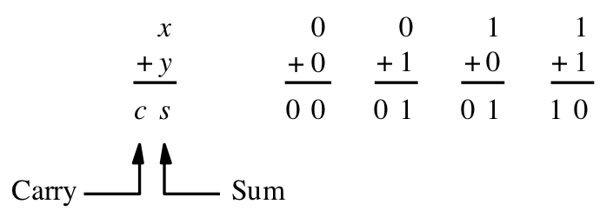
Adding two bits
(there are four possible cases)
[ Figure 3.1a from the textbook ]

Slide 7
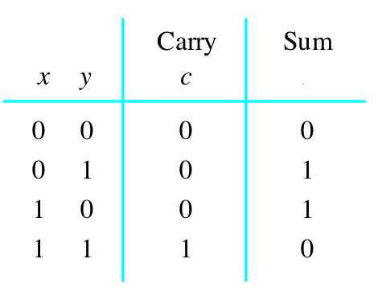
Adding two bits
(the truth table)
[ Figure 3.1b from the textbook ]

Slide 8
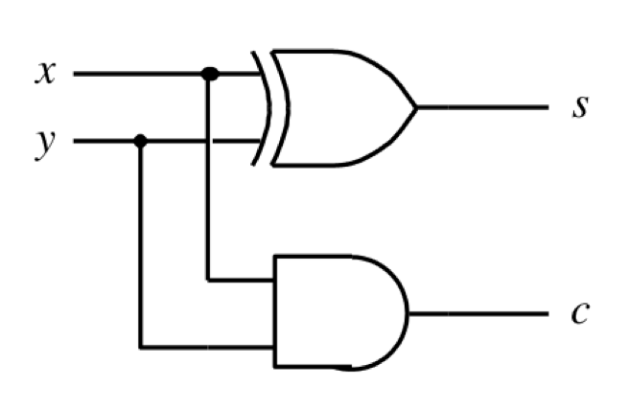
Adding two bits
(the logic circuit)
[ Figure 3.1c from the textbook ]

Slide 9
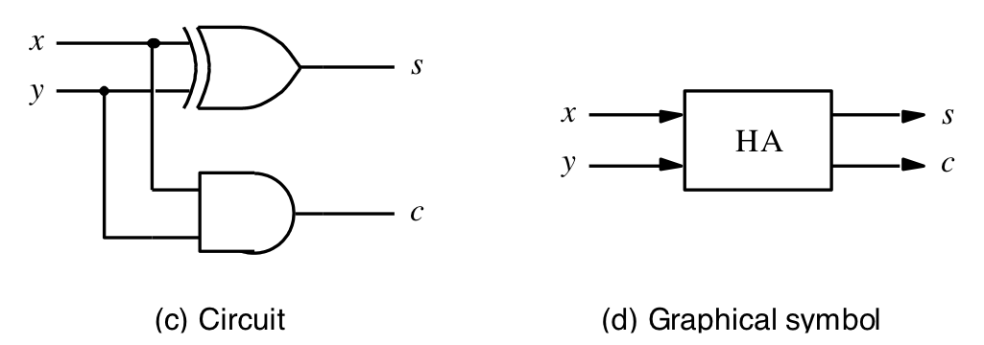
The Half-Adder
[ Figure 3.1c-d from the textbook ]

Slide 10
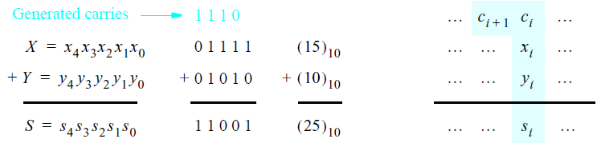
Addition of multibit numbers
Bit position i
[ Figure 3.2 from the textbook ]

Slide 11
Analogy with addition in base 10
c₃ c₂ c₁ c₀
x₂ x₁ x₀
y₂ y₁ y₀
s₂ s₁ s₀
+

Slide 12
Analogy with addition in base 10
3 8 9
1 5 7
5 4 6
+

Slide 13
Analogy with addition in base 10
0 1 1 0
3 8 9
1 5 7
5 4 6
carry
+

Slide 14
Analogy with addition in base 10
c₃ c₂ c₁ c₀
x₂ x₁ x₀
y₂ y₁ y₀
s₂ s₁ s₀
+

Slide 15
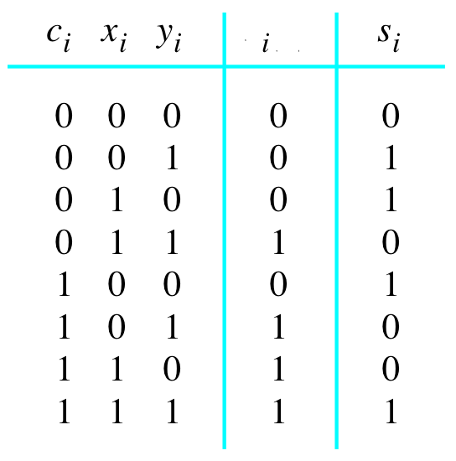

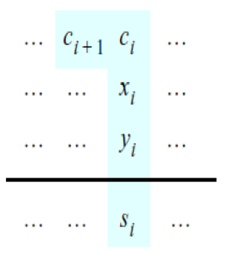
Problem Statement and Truth Table
[ Figure 3.2b from the textbook ]
[ Figure 3.3a from the textbook ]

Slide 16
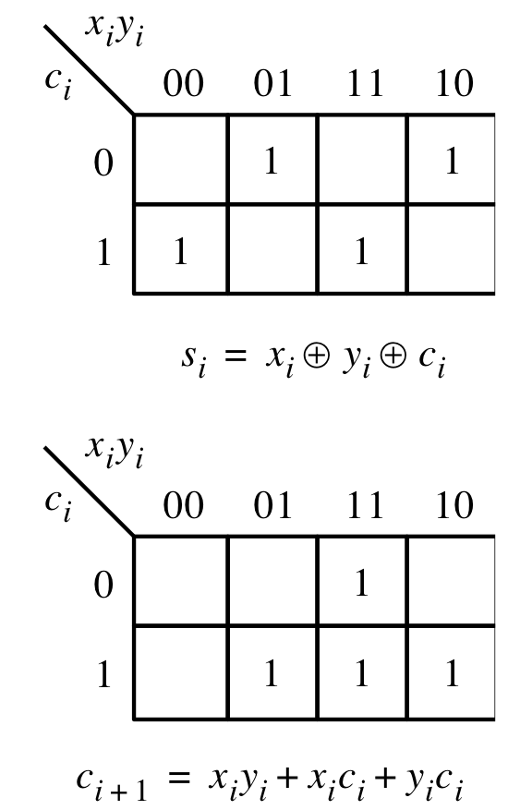
Let’s fill-in the two K-maps
[ Figure 3.3a-b from the textbook ]

Slide 17
Let’s fill-in the two K-maps
[ Figure 3.3a-b from the textbook ]

Slide 18
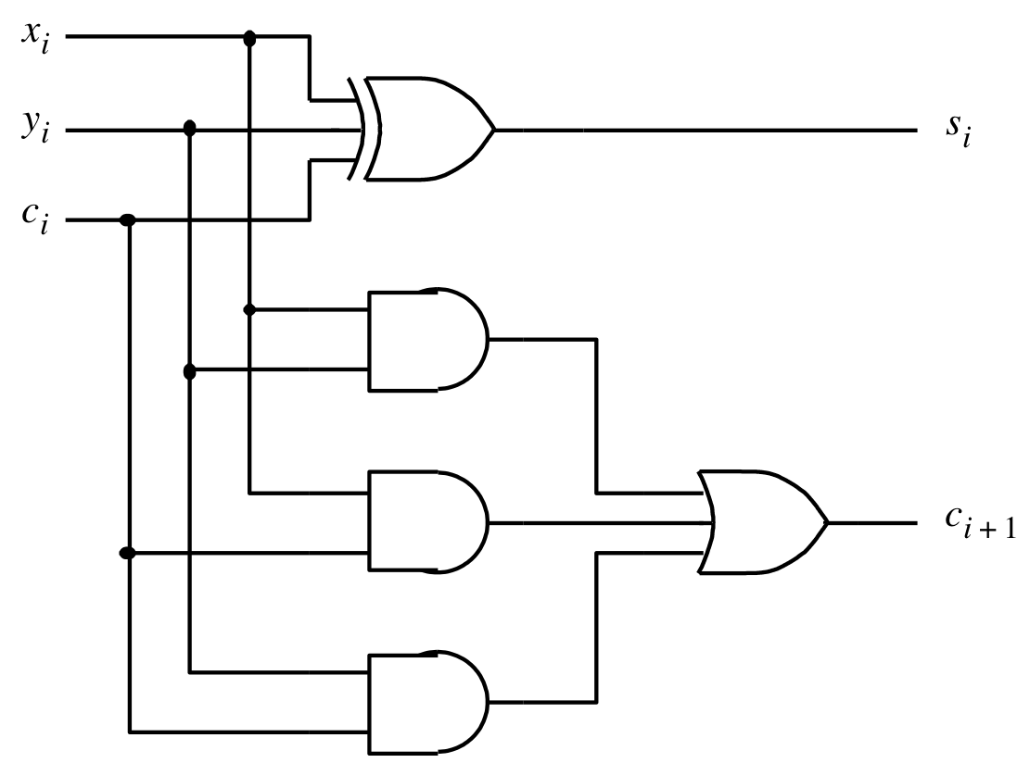


The circuit for the two expressions
[ Figure 3.3c from the textbook ]

Slide 19
This is called the Full-Adder
[ Figure 3.3c from the textbook ]

Slide 20

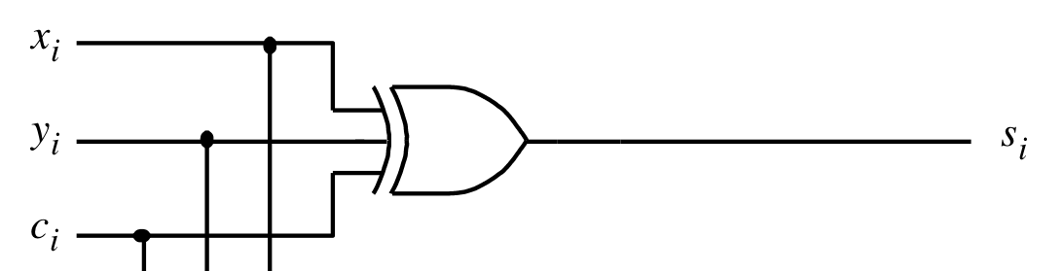
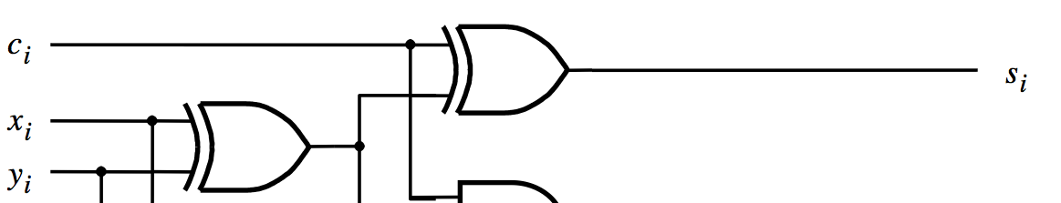
XOR Magic
(s_{i} can be implemented in two different ways)

Slide 21
A decomposed implementation
of the full-adder circuit
c
s
s
i
s
HA
c
i
x
i
HA
c
c
y
i
+
1
i
(a) Block diagram
c
i
s
i
x
i
y
i
c
i
+
1
(b) Detailed diagram
[ Figure 3.4 from the textbook ]

Slide 22
A decomposed implementation
of the full-adder circuit
c
s
s
i
s
HA
c
i
x
i
HA
c
c
y
i
+
1
i
(a) Block diagram
c
i
s
i
x
i
y
i
HA
c
i
+
1
HA
(b) Detailed diagram
[ Figure 3.4 from the textbook ]

Slide 23
The Full-Adder Abstraction
c
s
s
i
HA
i
x
s
c
i
HA
c
y
c
i
+
1
i

Slide 24
The Full-Adder Abstraction
c
s
i
i
x
FA
i
c
y
i
+
1
i

Slide 25
We can place the arrows anywhere
x_{i}
y_{i}
c_{i+1}
FA
c_{i}
s_{i}

Slide 26
n-bit ripple-carry adder
x
y
x
y
x
y
n –
1
n
–
1
1
1
0
0
c
c
c
c
1
c
n
FA
n
”
1
2
FA
FA
0
s
s
s
n
–
1
1
0
MSB position
LSB position
[ Figure 3.5 from the textbook ]

Slide 27
n-bit ripple-carry adder abstraction
x
y
x
y
x
y
n –
1
n
–
1
1
1
0
0
c
c
c
c
1
c
n
FA
n
”
1
2
FA
FA
0
s
s
s
n
–
1
1
0
MSB position
LSB position

Slide 28
n-bit ripple-carry adder abstraction
x
y
x
y
x
y
n –
1
n
–
1
1
1
0
0
c
c
n
0
s
s
s
n
–
1
1
0

Slide 29
The x and y lines are typically
grouped together for better visualization,
but the underlying logic remains the same
x
x
x
y
y
y
n –
1
1
0
n
–
1
1
0
c
c
n
0
s
s
s
n
–
1
1
0

Slide 31
Math Review: Subtraction
-
39
15
??

Slide 32
Math Review: Subtraction
-
39
15
24

Slide 33
Math Review: Subtraction
-
82
61
-
48
26
-
32
11
??
??
??

Slide 34
Math Review: Subtraction
-
82
61
-
48
26
-
32
11
21
22
21

Slide 36
Math Review: Subtraction
-
82
64
-
48
29
-
32
13
??
??
??

Slide 37
Math Review: Subtraction
-
82
64
-
48
29
-
32
13
18
19
19

Slide 39
The problems in which row are easier to calculate?
-
82
61
-
48
26
-
32
11
??
??
??
-
82
64
-
48
29
-
32
13
??
??
??

Slide 40
The problems in which row are easier to calculate?
-
82
61
-
48
26
-
32
11
21
22
21
Why?
-
82
64
-
48
29
-
32
13
18
19
19

Slide 41
Another Way to Do Subtraction
82 – 64 = 82 + 100 – 100 - 64

Slide 42
Another Way to Do Subtraction
82 – 64 = 82 + 100 – 100 - 64
= 82 + (100 – 64) - 100

Slide 43
Another Way to Do Subtraction
82 – 64 = 82 + 100 – 100 - 64
= 82 + (100 – 64) - 100
= 82 + (99 + 1 – 64) - 100

Slide 44
Another Way to Do Subtraction
82 – 64 = 82 + 100 – 100 - 64
= 82 + (100 – 64) - 100
= 82 + (99 + 1 – 64) - 100
= 82 + (99 – 64) +1 - 100

Slide 45
Another Way to Do Subtraction
82 – 64 = 82 + 100 – 100 - 64
= 82 + (100 – 64) - 100
= 82 + (99 + 1 – 64) - 100
Does not require borrows
= 82 + (99 – 64) +1 - 100

Slide 46
9’s Complement
(subtract each digit from 9)
-
99
64
35

Slide 47
10’s Complement
(subtract each digit from 9 and add 1 to the result)
-
99
64
35 + 1 = 36

Slide 48
Another Way to Do Subtraction
82 – 64 = 82 + (99 – 64) +1 - 100

Slide 49
Another Way to Do Subtraction
9’s complement
82 – 64 = 82 + (99 – 64) +1 - 100

Slide 50
Another Way to Do Subtraction
9’s complement
82 – 64 = 82 + (99 – 64) +1 - 100
= 82 + 35 + 1 - 100

Slide 51
Another Way to Do Subtraction
9’s complement
82 – 64 = 82 + (99 – 64) +1 - 100
10’s complement
= 82 + 35 + 1 - 100

Slide 52
Another Way to Do Subtraction
9’s complement
82 – 64 = 82 + (99 – 64) +1 - 100
10’s complement
= 82 + 35 + 1 - 100
= 82 + 36 - 100

Slide 53
Another Way to Do Subtraction
9’s complement
82 – 64 = 82 + (99 – 64) +1 - 100
10’s complement
= 82 + 35 + 1 - 100
= 82 + 36 - 100
// Add the first two.
= 118 - 100

Slide 54
Another Way to Do Subtraction
9’s complement
82 – 64 = 82 + (99 – 64) +1 - 100
10’s complement
= 82 + 35 + 1 - 100
= 82 + 36 - 100
// Add the first two.
= 118 - 100
// Just delete the leading 1.
// No need to subtract 100.
= 18

Slide 56
Formats for representation of integers
b
n
–
1
b
1
b
0
Magnitude
MSB
(a) Unsigned number
b
n
–
1
b
n
–
2
b
1
b
0
Sign
Magnitude
0 denotes
+
1 denotes
–
MSB
(b) Signed number
[ Figure 3.7 from the textbook ]

Slide 57
Negative numbers can be represented in following ways
Sign and magnitude
1’s complement
2’s complement

Slide 58
1’s complement
Let K be the negative equivalent of an n-bit positive number P.
Then, in 1’s complement representation K is obtained by subtracting P from 2^{n} – 1, namely
K = (2^{n} – 1) – P
This means that K can be obtained by inverting all bits of P.

Slide 59
Find the 1’s complement of …
0 1 0 1
0 0 1 0
0 0 1 1
0 1 1 1

Slide 60
Find the 1’s complement of …
0 1 0 1
0 0 1 0
1 0 1 0
1 1 0 1
0 0 1 1
0 1 1 1
1 1 0 0
1 0 0 0
Just flip 1's to 0's and vice versa.

Slide 61
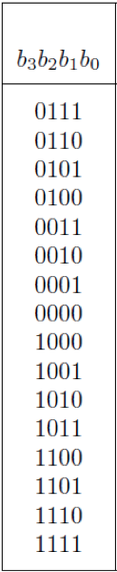
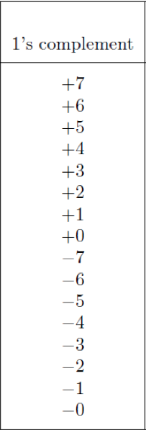
A) Example of 1’s complement addition
(
+
5
)
0 1 0 1
+
(
+
2
)
+
0 0 1 0
(
+
7
)
0 1 1 1
[ Figure 3.8 from the textbook ]

Slide 62
A) Example of 1’s complement addition
(
+
5
)
0 1 0 1
+
(
+
2
)
+
0 0 1 0
(
+
7
)
0 1 1 1

Slide 63
B) Example of 1’s complement addition
(
-
5
)
1 0 1 0
+
(
+
2
)
+
0 0 1 0
(
-
3
)
1 1 0 0
[ Figure 3.8 from the textbook ]

Slide 64
B) Example of 1’s complement addition
(
-
5
)
1 0 1 0
+
(
+
2
)
+
0 0 1 0
(
-
3
)
1 1 0 0

Slide 65
C) Example of 1’s complement addition
(
+
5
)
0 1 0 1
+
(
–
2
)
+
1 1 0 1
(
+
3
)
1
0 0 1 0
[ Figure 3.8 from the textbook ]

Slide 66
C) Example of 1’s complement addition
(
+
5
)
0 1 0 1
+
(
–
2
)
+
1 1 0 1
(
+
3
)
1
0 0 1 0

Slide 67
C) Example of 1’s complement addition
(
+
5
)
0 1 0 1
+
(
–
2
)
+
1 1 0 1
(
+
3
)
1
0 0 1 0
But this is 2!

Slide 68
C) Example of 1’s complement addition
(
+
5
)
0 1 0 1
+
(
–
2
)
+
1 1 0 1
(
+
3
)
1
0 0 1 0
1
0 0 1 1
We need to perform one
more addition to get the result.

Slide 69
C) Example of 1’s complement addition
(
+
5
)
0 1 0 1
+
(
–
2
)
+
1 1 0 1
(
+
3
)
1
0 0 1 0
1
0 0 1 1
We need to perform one
more addition to get the result.

Slide 70
D) Example of 1’s complement addition
(
–
5
)
1 0 1 0
+
(
–
2
)
+
1 1 0 1
(
–
7
)
1
0 1 1 1
[ Figure 3.8 from the textbook ]

Slide 71
D) Example of 1’s complement addition
(
–
5
)
1 0 1 0
+
(
–
2
)
+
1 1 0 1
(
–
7
)
1
0 1 1 1

Slide 72
D) Example of 1’s complement addition
(
–
5
)
1 0 1 0
+
(
–
2
)
+
1 1 0 1
(
–
7
)
1
0 1 1 1
But this is +7!

Slide 73
D) Example of 1’s complement addition
(
–
5
)
1 0 1 0
+
(
–
2
)
+
1 1 0 1
(
–
7
)
1
0 1 1 1
1
1 0 0 0
We need to perform one
more addition to get the result.

Slide 74
D) Example of 1’s complement addition
(
–
5
)
1 0 1 0
+
(
–
2
)
+
1 1 0 1
(
–
7
)
1
0 1 1 1
1
1 0 0 0
We need to perform one
more addition to get the result.

Slide 75
2’s complement
Let K be the negative equivalent of an n-bit positive number P.
Then, in 2’s complement representation K is obtained by subtracting P from 2^{n} , namely
K = 2^{n} – P

Slide 76
Deriving 2’s complement
For a positive n-bit number P, let K₁ and K₂ denote its 1’s and 2’s complements, respectively.
K₁ = (2^{n} – 1) – P
K₂ = 2^{n} – P
Since K₂ = K₁ + 1, it is evident that in a logic circuit the 2’s complement can computed by inverting all bits of P and then adding 1 to the resulting 1’s-complement number.

Slide 77
Find the 2’s complement of …
0 1 0 1
0 0 1 0
0 1 0 0
0 1 1 1

Slide 78
Find the 2’s complement of …
0 1 0 1
0 0 1 0
1 0 1 0
1 1 0 1
0 1 0 0
0 1 1 1
1 0 1 1
1 0 0 0
Invert all bits.

Slide 79
Find the 2’s complement of …
0 1 0 1
0 0 1 0
1 0 1 0
1 1 0 1
+
+
1
1
1 0 1 1
1 1 1 0
0 1 0 0
0 1 1 1
1 0 1 1
1 0 0 0
+
+
1
1
1 1 0 0
1 0 0 1
Then add 1.

Slide 80
Quick Way to find 2’s complement
Scan the binary number from right to left
Copy all bits that are 0 from right to left
Stop at the first 1
Copy that 1 as well
Invert all remaining bits

Slide 81
Find the 2’s complement of …
0 1 0 1
0 0 1 0
0 1 0 0
0 1 1 1

Slide 82
Find the 2’s complement of …
0 1 0 1
0 0 1 0
. . . .
. . . 0
0 1 0 0
0 1 1 1
. . 0 0
. . . .
Copy all bits that are 0 from right to left.

Slide 83
Find the 2’s complement of …
0 1 0 1
0 0 1 0
. . . 1
. . 1 0
0 1 0 0
0 1 1 1
. 1 0 0
. . . 1
Stop at the first 1. Copy that 1 as well.

Slide 84
Find the 2’s complement of …
0 1 0 1
0 0 1 0
1 0 1 1
1 1 1 0
0 1 0 0
0 1 1 1
1 1 0 0
1 0 0 1
Invert all remaining bits.

Slide 85
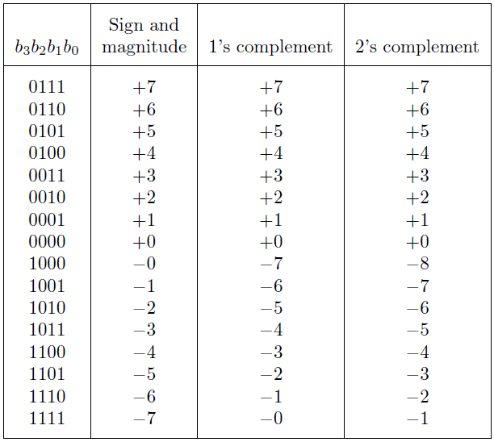
Interpretation of four-bit signed integers
[ Table 3.2 from the textbook ]

Slide 86
Interpretation of four-bit signed integers
Notice that in this representation there are two zeros!

Slide 87
Interpretation of four-bit signed integers
There are two zeros in this representation as well!

Slide 88
Interpretation of four-bit signed integers
In this representation there is one more negative number.

Slide 89
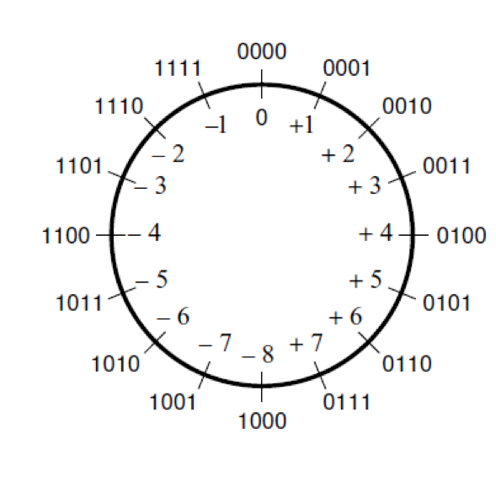
The number circle for 2's complement
[ Figure 3.11a from the textbook ]

Slide 90
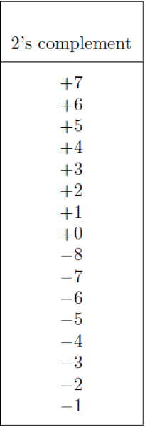
A) Example of 2’s complement addition
(
+
5
)
0 1 0 1
+
(
+
2
)
+
0 0 1 0
(
+
7
)
0 1 1 1
[ Figure 3.9 from the textbook ]

Slide 91
B) Example of 2’s complement addition
(
–
5
)
1 0 1 1
+
(
+
2
)
+
0 0 1 0
(
–
3
)
1 1 0 1
[ Figure 3.9 from the textbook ]

Slide 92
C) Example of 2’s complement addition
(
+
5
)
0 1 0 1
+
(
–
2
)
+
1 1 1 0
(
+
3
)
1
0 0 1 1
ignore
[ Figure 3.9 from the textbook ]

Slide 93
D) Example of 2’s complement addition
(
–
5
)
1 0 1 1
+
(
–
2
)
+
1 1 1 0
(
–
7
)
1
1 0 0 1
ignore
[ Figure 3.9 from the textbook ]

Slide 95
Example of 2’s complement subtraction
(
+
5
)
0 1 0 1
0 1 0 1
–
(
+
2
)
–
0 0 1 0
+
1 1 1 0
(
+
3
)
1
0 0 1 1
ignore
means take the 2's complement
[ Figure 3.10 from the textbook ]

Slide 96
Example of 2’s complement subtraction
(
)
1 0 1 1
1 0 1 1
–
5
–
(
+
2
)
–
0 0 1 0
+
1 1 1 0
(
)
1
1 0 0 1
–
7
ignore
[ Figure 3.10 from the textbook ]

Slide 97
Example of 2’s complement subtraction
(
+
5
)
0 1 0 1
0 1 0 1
–
(
)
–
+
–
2
1 1 1 0
0 0 1 0
(
+
7
)
0 1 1 1
[ Figure 3.10 from the textbook ]

Slide 98
Example of 2’s complement subtraction
(
)
1 0 1 1
1 0 1 1
–
5
–
(
)
–
+
–
2
1 1 1 0
0 0 1 0
(
)
1 1 0 1
–
3
[ Figure 3.10 from the textbook ]

Slide 99
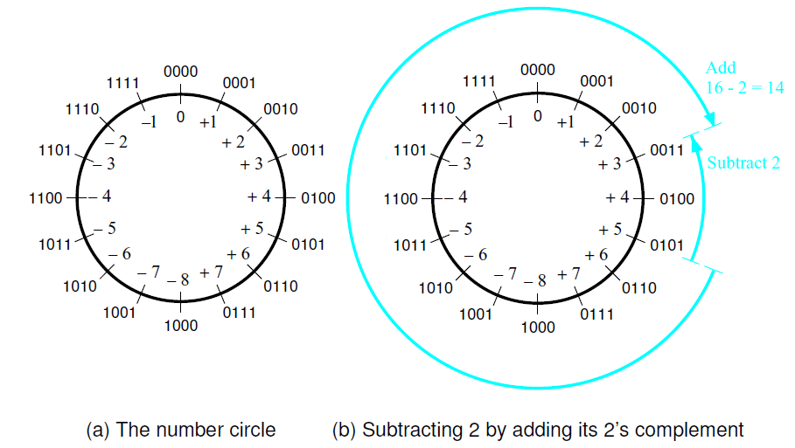
Graphical interpretation of four-bit 2’s complement numbers
[ Figure 3.11 from the textbook ]

Slide 100
Take-Home Message
Subtraction can be performed by simply adding the 2’s complement of the second number, regardless of the signs of the two numbers.
Thus, the same adder circuit can be used to perform both addition and subtraction !!!

Slide 101
Adder/subtractor unit
y
y
y
n
–
1
1
0
Add
⁄
Sub
control
x
x
x
n
–
1
1
0
c
n
c
n
-bit adder
0
s
s
s
n
–
1
1
0
[ Figure 3.12 from the textbook ]

Slide 102
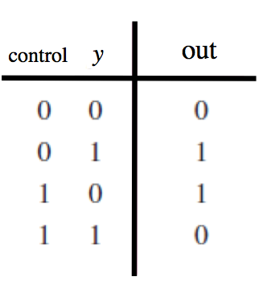
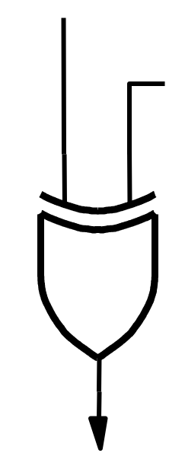
XOR Tricks
control
out
y

Slide 103
XOR as a repeater
0
y
y

Slide 104
XOR as an inverter
1
y
y

Slide 105
Addition: when control = 0
y
y
y
n
–
1
1
0
Add
⁄
Sub
control
x
x
x
n
–
1
1
0
c
n
c
n
-bit adder
0
s
s
s
n
–
1
1
0
[ Figure 3.12 from the textbook ]

Slide 106
Addition: when control = 0
y
y
y
0
n
–
1
1
0
Add
⁄
Sub
0
0
0
control
x
x
x
n
–
1
1
0
c
n
c
n
-bit adder
0
s
s
s
n
–
1
1
0
[ Figure 3.12 from the textbook ]

Slide 107
Addition: when control = 0
y
y
y
0
n
–
1
1
0
Add
⁄
Sub
0
0
0
control
x
x
x
n
–
1
1
0
y_{n-1}
…
y₁
y₀
c
n
c
n
-bit adder
0
s
s
s
n
–
1
1
0
[ Figure 3.12 from the textbook ]

Slide 108
Subtraction: when control = 1
y
y
y
n
–
1
1
0
Add
⁄
Sub
control
x
x
x
n
–
1
1
0
c
n
c
n
-bit adder
0
s
s
s
n
–
1
1
0
[ Figure 3.12 from the textbook ]

Slide 109
Subtraction: when control = 1
y
y
y
1
n
–
1
1
0
Add
⁄
Sub
1
1
1
control
x
x
x
n
–
1
1
0
c
n
c
n
-bit adder
0
s
s
s
n
–
1
1
0
[ Figure 3.12 from the textbook ]

Slide 110
Subtraction: when control = 1
y
y
y
1
n
–
1
1
0
Add
⁄
Sub
1
1
1
control
x
x
x
n
–
1
1
0
y_{n-1}
…
y₁
y₀
c
n
c
n
-bit adder
0
s
s
s
n
–
1
1
0
[ Figure 3.12 from the textbook ]

Slide 111
Subtraction: when control = 1
y
y
y
1
n
–
1
1
0
Add
⁄
Sub
1
1
1
control
x
x
x
n
–
1
1
0
y_{n-1}
…
y₁
y₀
c
n
c
n
-bit adder
1
0
carry for the
first column!
s
s
s
n
–
1
1
0
[ Figure 3.12 from the textbook ]

Slide 112
Examples of determination of overflow
(
+
7
)
0 1 1 1
(
–
7
)
1 0 0 1
(
)
+
(
)
+
+
+
2
0 0 1 0
+
+
2
0 0 1 0
(
+
9
)
1 0 0 1
(
–
5
)
1 0 1 1
(
+
7
)
+
0 1 1 1
(
–
7
)
+
1 0 0 1
+
(
–
2
)
1 1 1 0
+
(
–
2
)
1 1 1 0
(
+
5
)
1
0 1 0 1
(
–
9
)
1
0 1 1 1
[ Figure 3.13 from the textbook ]

Slide 113
Examples of determination of overflow
0 1 1 0 0
0 0 0 0 0
(
+
7
)
0 1 1 1
(
–
7
)
1 0 0 1
(
)
+
(
)
+
+
+
2
0 0 1 0
+
+
2
0 0 1 0
(
+
9
)
1 0 0 1
(
–
5
)
1 0 1 1
1 1 1 0 0
1 0 0 0 0
(
+
7
)
+
0 1 1 1
(
–
7
)
+
1 0 0 1
+
(
–
2
)
1 1 1 0
+
(
–
2
)
1 1 1 0
(
+
5
)
1
0 1 0 1
(
–
9
)
1
0 1 1 1
Include the carry bits: c₄ c₃ c₂ c₁ c₀

Slide 114
Examples of determination of overflow
0 1 1 0 0
0 0 0 0 0
(
+
7
)
0 1 1 1
(
–
7
)
1 0 0 1
(
)
+
(
)
+
+
+
2
0 0 1 0
+
+
2
0 0 1 0
(
+
9
)
1 0 0 1
(
–
5
)
1 0 1 1
1 1 1 0 0
1 0 0 0 0
(
+
7
)
+
0 1 1 1
(
–
7
)
+
1 0 0 1
+
(
–
2
)
1 1 1 0
+
(
–
2
)
1 1 1 0
(
+
5
)
1
0 1 0 1
(
–
9
)
1
0 1 1 1
Include the carry bits: c₄ c₃ c₂ c₁ c₀

Slide 115
Examples of determination of overflow
c
4
=
0
c
4
=
0
c
=
1
0 1 1 0 0
0 0 0 0 0
c
=
0
3
(
+
7
)
0 1 1 1
(
–
7
)
1 0 0 1
3
(
)
+
(
)
+
+
+
2
0 0 1 0
+
+
2
0 0 1 0
(
+
9
)
1 0 0 1
(
–
5
)
1 0 1 1
c
4
=
1
c
4
=
1
c
=
1
1 1 1 0 0
1 0 0 0 0
c
=
0
3
(
+
7
)
0 1 1 1
(
–
7
)
1 0 0 1
3
+
+
+
(
–
2
)
1 1 1 0
+
(
–
2
)
1 1 1 0
(
+
5
)
1
0 1 0 1
(
–
9
)
1
0 1 1 1
Include the carry bits: c₄ c₃ c₂ c₁ c₀

Slide 116
Examples of determination of overflow
c
4
=
0
c
4
=
0
c
=
1
0 1 1 0 0
0 0 0 0 0
c
=
0
3
(
+
7
)
0 1 1 1
(
–
7
)
1 0 0 1
3
(
)
+
(
)
+
+
+
2
0 0 1 0
+
+
2
0 0 1 0
(
+
9
)
1 0 0 1
(
–
5
)
1 0 1 1
c
4
=
1
c
4
=
1
c
=
1
1 1 1 0 0
1 0 0 0 0
c
=
0
3
(
+
7
)
0 1 1 1
(
–
7
)
1 0 0 1
3
+
+
+
(
–
2
)
1 1 1 0
+
(
–
2
)
1 1 1 0
(
+
5
)
1
0 1 0 1
(
–
9
)
1
0 1 1 1
Overflow occurs only in these two cases.

Slide 117
Examples of determination of overflow
c
4
=
0
c
4
=
0
c
=
1
0 1 1 0 0
0 0 0 0 0
c
=
0
3
(
+
7
)
0 1 1 1
(
–
7
)
1 0 0 1
3
(
)
+
(
)
+
+
+
2
0 0 1 0
+
+
2
0 0 1 0
(
+
9
)
1 0 0 1
(
–
5
)
1 0 1 1
c
4
=
1
c
4
=
1
c
=
1
1 1 1 0 0
1 0 0 0 0
c
=
0
3
(
+
7
)
0 1 1 1
(
–
7
)
1 0 0 1
3
+
+
+
(
–
2
)
1 1 1 0
+
(
–
2
)
1 1 1 0
(
+
5
)
1
0 1 0 1
(
–
9
)
1
0 1 1 1
Overflow = c₃c₄ + c₃c₄

Slide 118
Examples of determination of overflow
c
4
=
0
c
4
=
0
c
=
1
0 1 1 0 0
0 0 0 0 0
c
=
0
3
(
+
7
)
0 1 1 1
(
–
7
)
1 0 0 1
3
(
)
+
(
)
+
+
+
2
0 0 1 0
+
+
2
0 0 1 0
(
+
9
)
1 0 0 1
(
–
5
)
1 0 1 1
c
4
=
1
c
4
=
1
c
=
1
1 1 1 0 0
1 0 0 0 0
c
=
0
3
(
+
7
)
0 1 1 1
(
–
7
)
1 0 0 1
3
+
+
+
(
–
2
)
1 1 1 0
+
(
–
2
)
1 1 1 0
(
+
5
)
1
0 1 0 1
(
–
9
)
1
0 1 1 1
Overflow = c₃c₄ + c₃c₄
XOR

Slide 119
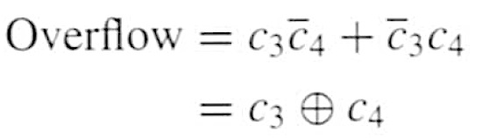
Calculating overflow for 4-bit numbers
with only three significant bits

Slide 120

Calculating overflow for n-bit numbers
with only n-1 significant bits

Slide 121



Another way to look at the overflow issue

Slide 122

Another way to look at the overflow issue
If both numbers that we are adding have the same sign
but the sum does not, then we have an overflow.

Slide 123
Questions?

Slide 124
THE END

